Slide 1
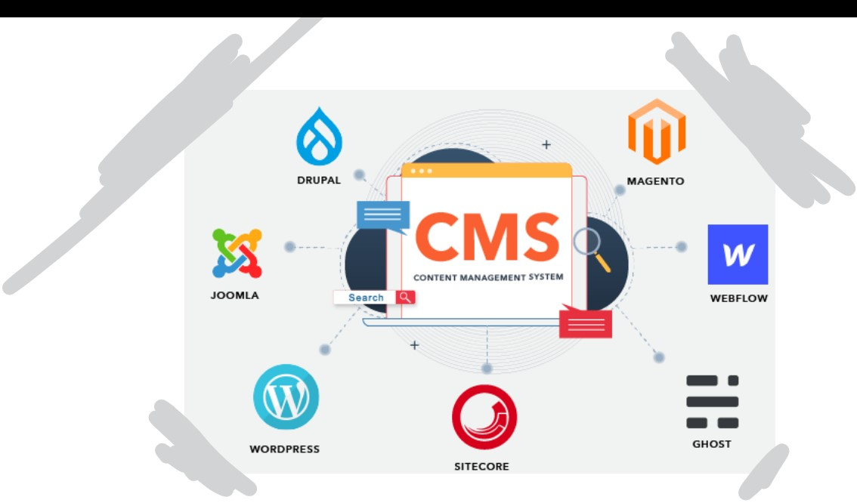
Content Management System (02)
INSTRUCTOR: Sir Farooq Iqbal
Team members:
1- SYEDA ANSHRAH GILLANI
2-Umema Mujeeb
3-Maheen ALI
4-AREEJ ASIF

Slide 2
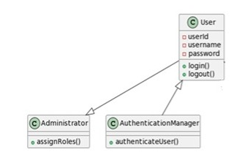
Classes to Data, Routines
1- User Management Subsystem
1.User Class:
Attributes: UserID, UserName, Email
Methods: createUser(), editUserDetails(), authenticateUser()
2.Administrator Class:
Attributes: AdminID, AdminName, Email
Methods: configureSystem(), manageUserRoles(), authenticateAdministrator()
3.AuthenticationManager Class:
Attributes: None
Methods: authenticate(User user), validateCredentials(String username, String password)

Slide 3
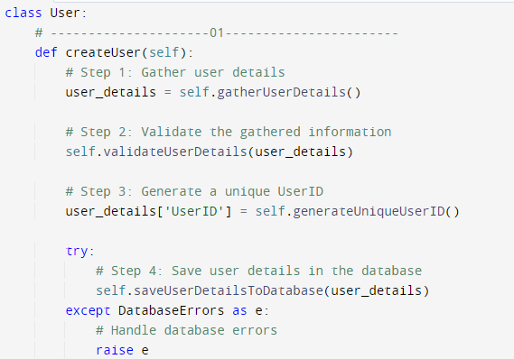
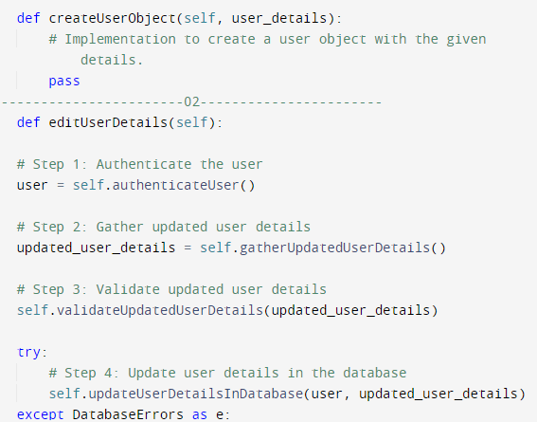
User Class – Internal routines Design

Slide 4

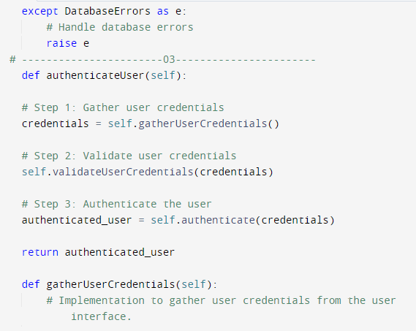
User Class – Internal routines Design

Slide 5
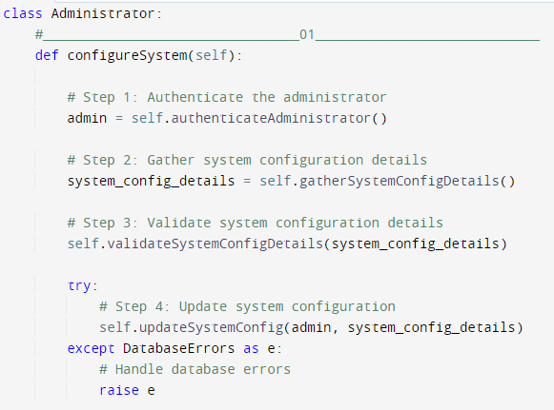
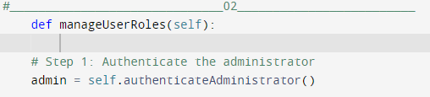
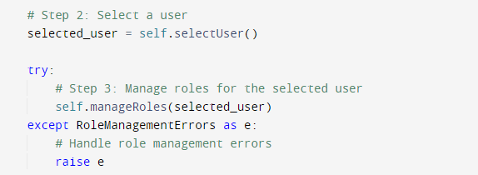
Administrator Class – Internal routines Design

Slide 6
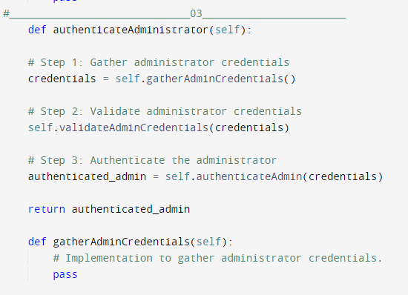
Administrator Class – Internal routines Design

Slide 7
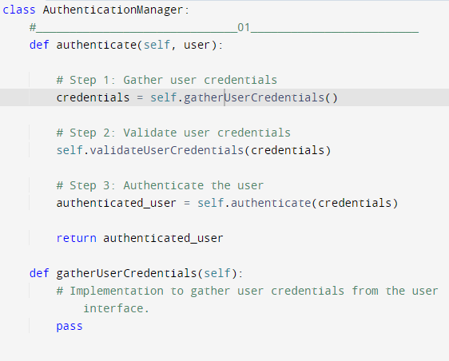
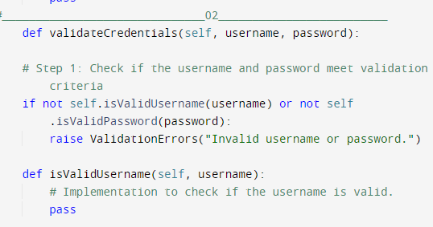
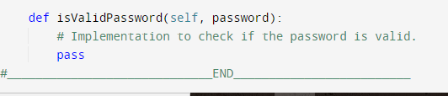
AuthenticationManager Class – Internal routines Design

Slide 8
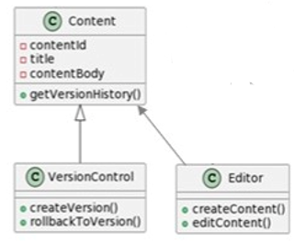
Classes to Data, Routines
2- Content Creation & Editing Subsystem
Content Class:
Attributes: ContentID, Title, DateCreated
Methods: createContent(User creator, String title), editContent(User editor, String newTitle), applyVersionControl()
Editor Class:
Attributes: EditorID, EditorName
Methods: editContent(Content content, String newTitle), reviewContent(Content content), notifyAuthor()
VersionControl Class:
Attributes: VersionID, Changes, DateModified
Methods: trackChanges(Content content), saveVersion()

Slide 9
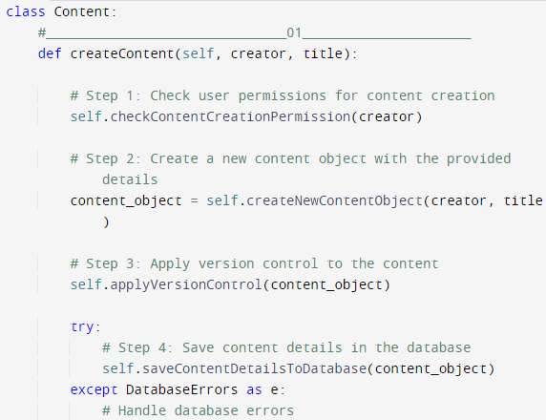
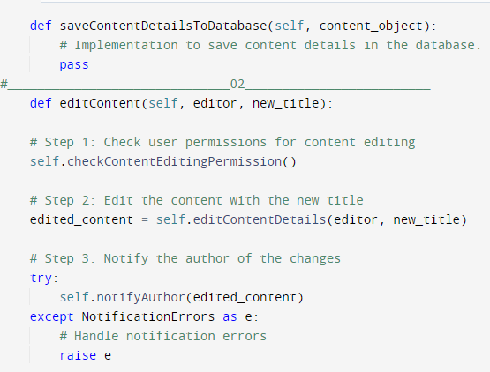
Content Class – Internal routines Design

Slide 10
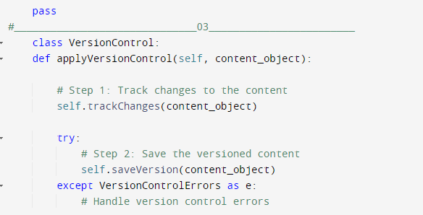
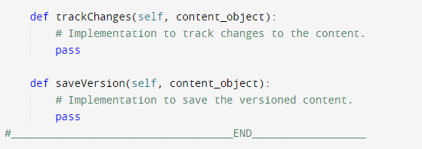
Content Class – Internal routines Design

Slide 11
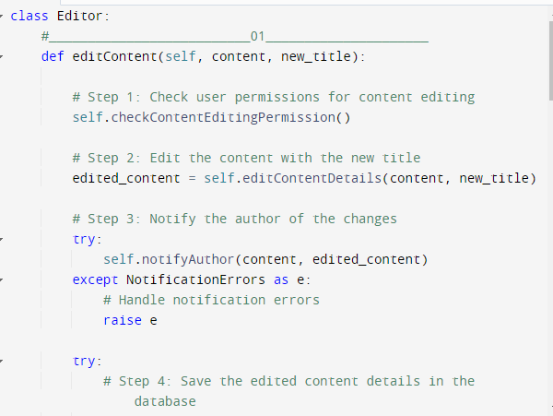
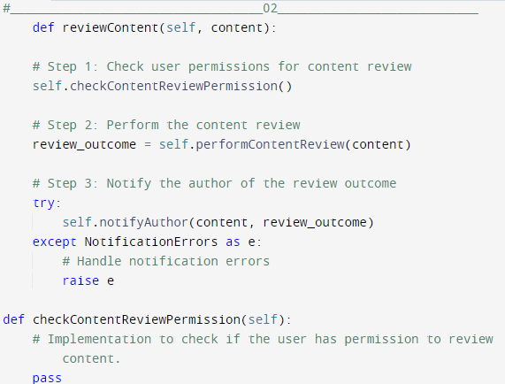
Editor Class – Internal routines Design

Slide 12
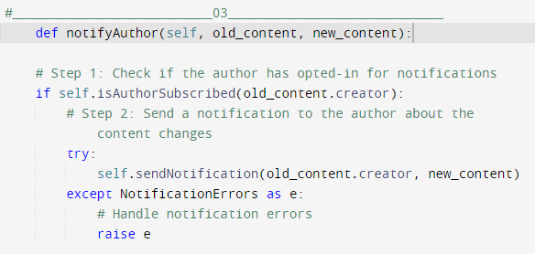
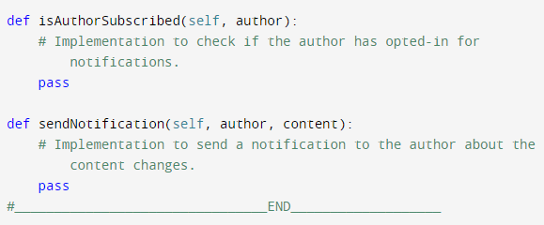
Editor Class – Internal routines Design

Slide 13
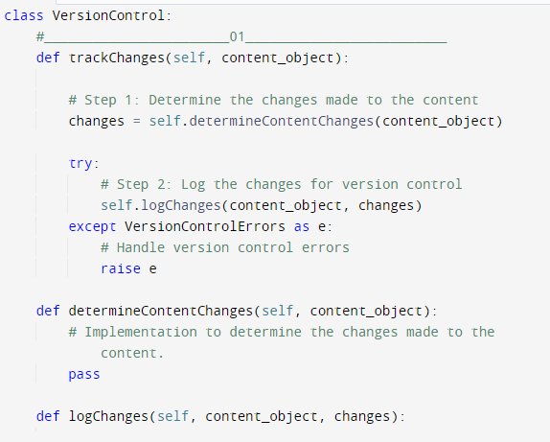
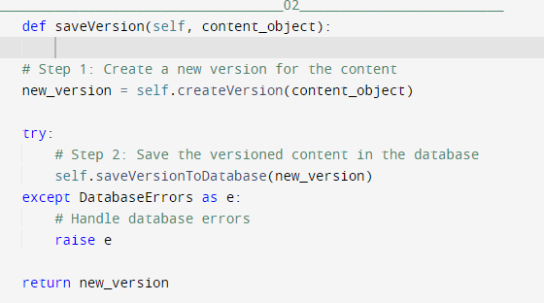
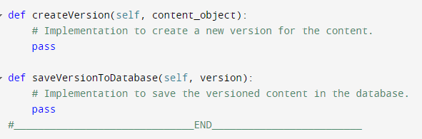
VersionControl Class – Internal routines Design

Slide 14
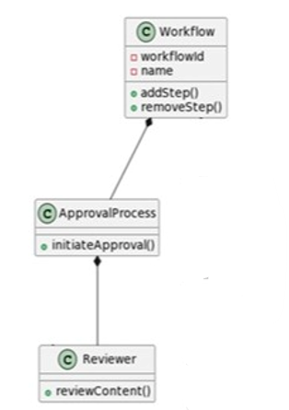
Classes to Data, Routines & Internal Routine Designs
3- Workflow & Approval Subsystem
Workflow Class:
Attributes: WorkflowID, Steps, Status
Methods: initiateWorkflow(Content content), progressWorkflow(), notifyReviewers()
ApprovalProcess Class:
Attributes: ApprovalProcessID, Approvers, Status
Methods: approveContent(Content content), rejectContent(Content content), notifyAuthor()
Reviewer Class:
Attributes: ReviewerID, ReviewerName
Methods: reviewContent(Content content), notifyOutcome()

Slide 15
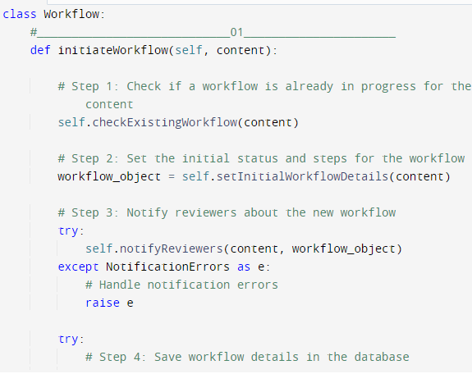
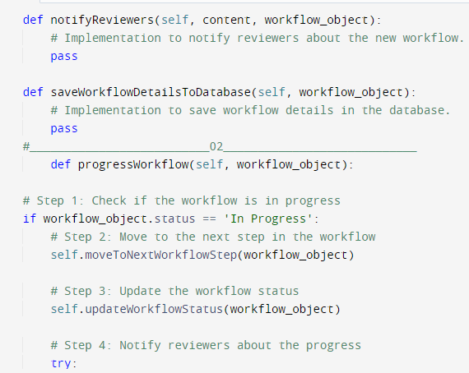
Workflow Class – Internal routines Design

Slide 16
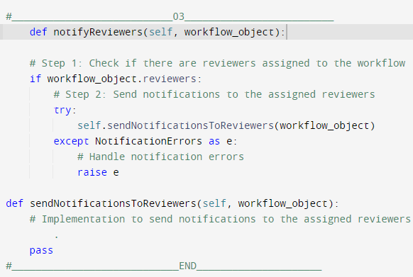
Workflow Class – Internal routines Design

Slide 17
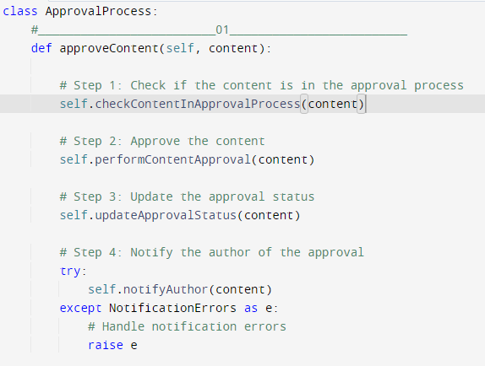
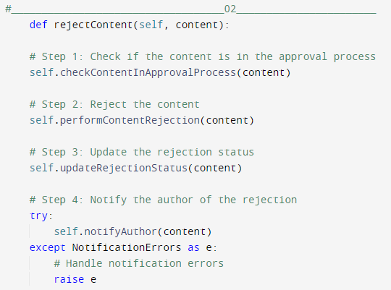
ApprovalProcess Class – Internal routines Design

Slide 18
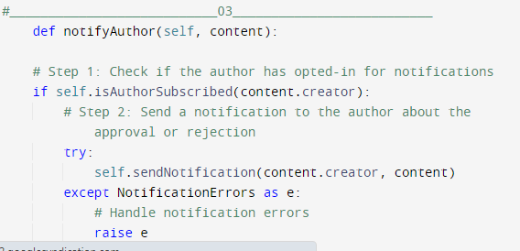
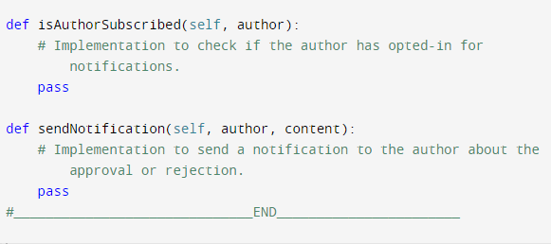
ApprovalProcess Class – Internal routines Design

Slide 19
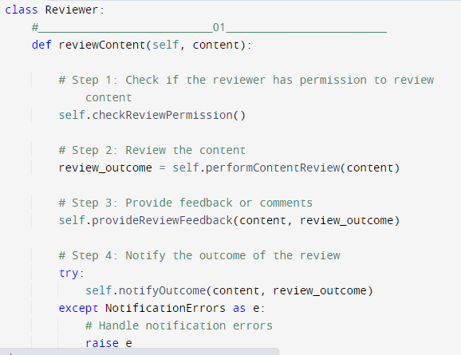
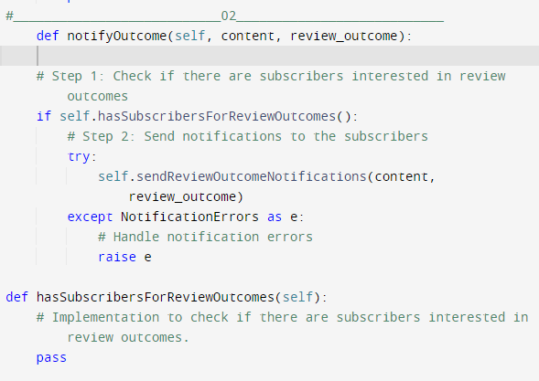
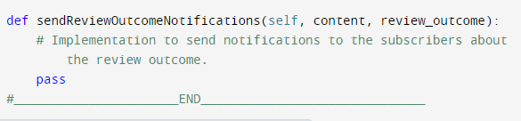
Reviewer Class – Internal routines Design

Slide 20
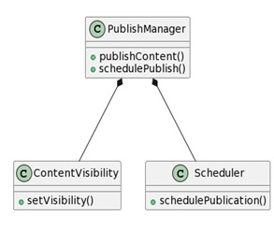
Classes to Data, Routines
4- Publishing Subsystem
PublishManager Class:
Attributes: PublishManagerID, PublishManagerName
Methods: publishContent(Content content), schedulePublication(Content content, Date publishDate), notifySubscribers()
ContentVisibility Class:
Attributes: ContentVisibilityID, VisibilitySettings
Methods: setVisibility(Content content, User user), applyVisibilitySettings()
Scheduler Class:
Attributes: SchedulerID, ScheduleSettings
Methods: scheduleTask(Date date, Task task), executeTask(Task task)

Slide 21
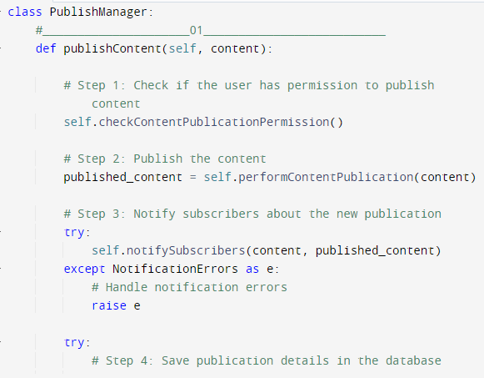
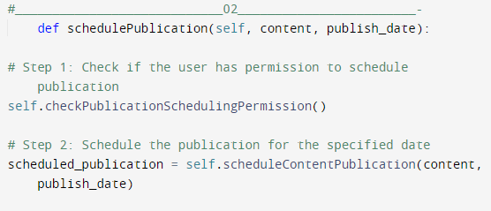
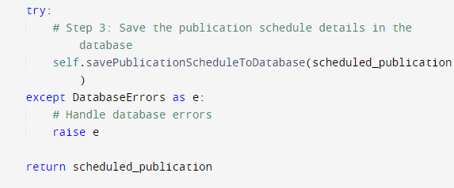
Publish ManagerClass – Internal routines Design

Slide 22
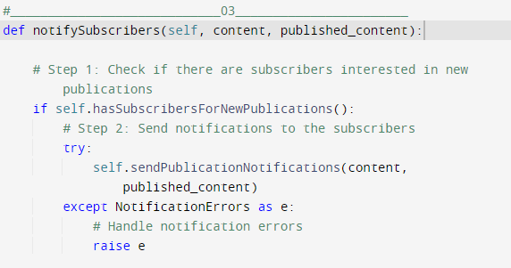
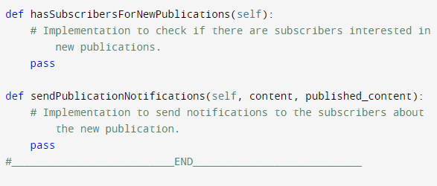
Publish ManagerClass – Internal routines Design

Slide 23
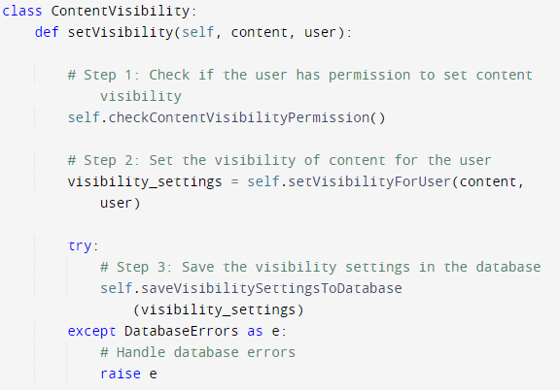
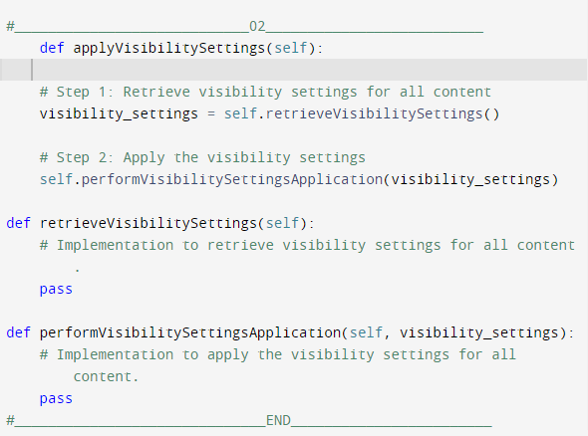
Content Visibility Class – Internal routines Design

Slide 24
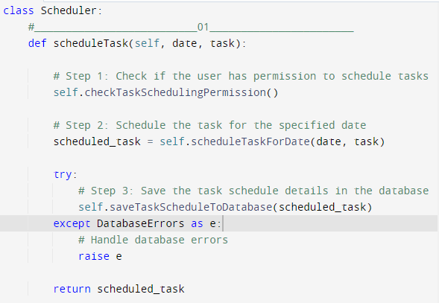
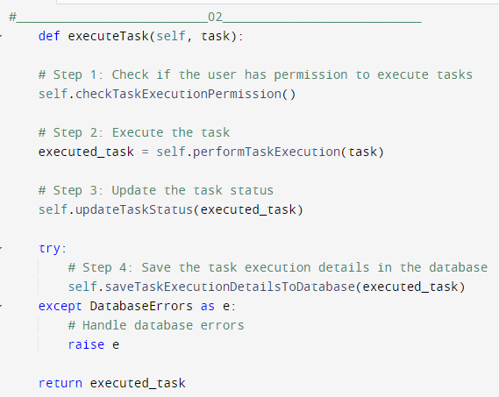
Scheduler Class – Internal routines Design

Slide 25
THANK YOU

